Slide 1
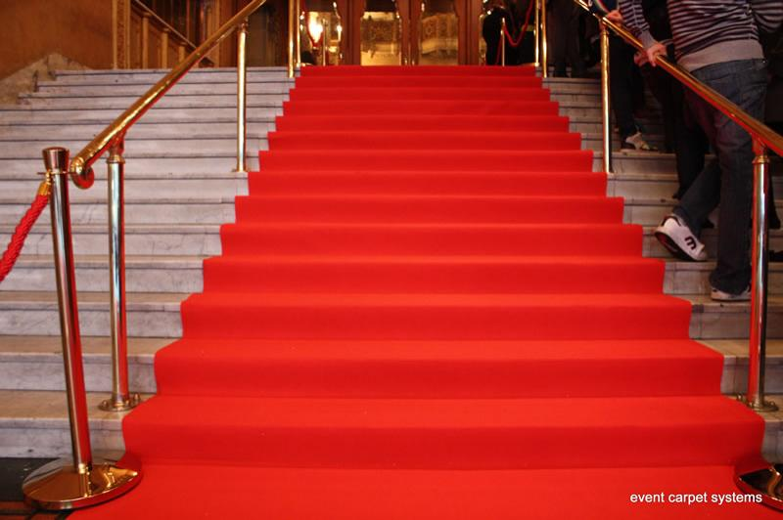
Culminating Events
Final
Culminating Events
AND DEMONSTRATIONS OF OUTCOMES

Slide 2
A/K/A AUTHENTIC ASSESSMENTS
OR ALTERNATIVE ASSESSMENTS

Slide 3
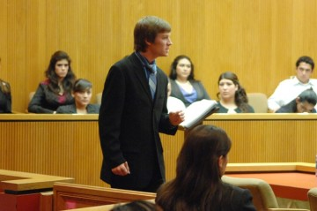
MOCK TRIALS
A 12-member jury found Miss Curly Pig guilty of attempted wolf cooking in 2nd District Court on Monday.
Central Union High School’s David Armenta delivers his opening statement for the prosecution Thursday during the second night of the Imperial County Mock Trial at the Imperial County Superior Court in El Centro.
Classroom Law Project

Slide 4
DEBATES
Middle School Public Debate Program

Slide 5
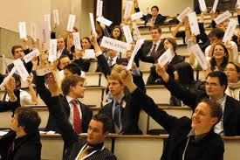
SIMULATIONS
Model United Nations Program – middle school, high school and university

Slide 6
DIGITAL PORTFOLIOS

Slide 7
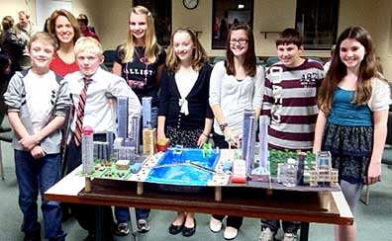
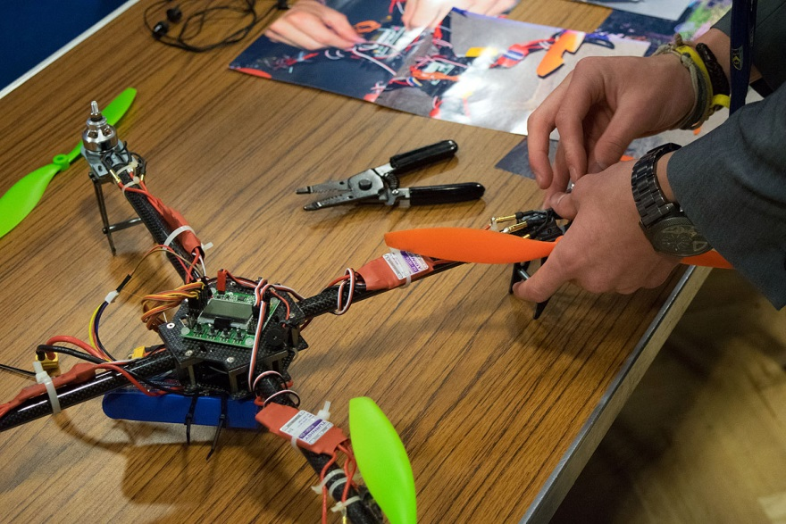
EXTENDED PROJECTS
Middle School Future City Competition

Slide 8
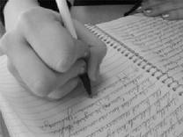
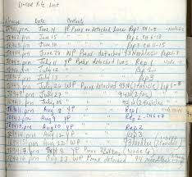
LOGS AND JOURNALS

Slide 9
STUDENT INTERVIEWS

Slide 10
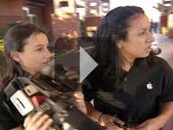
STUDENT-PRODUCED VIDEOS
Click picture to watch excellent video.

Slide 11
WRITING SAMPLES
Click book to view contents.

Slide 12
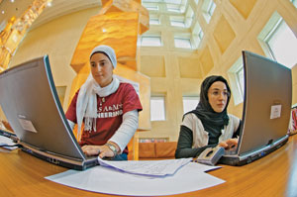
GLOBAL COLLABORATIONS
Students in Qatar, UAE.
Collaborative movie making
Food and Culture; iEARN: ePals and many more in workbook.

Slide 13
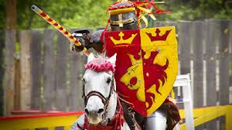
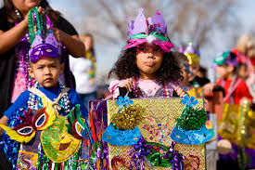
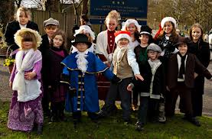
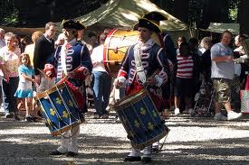
FESTIVAL FOR PERIOD IN HISTORY

Slide 14
STUDENT-ORGANIZED CONFERENCE

Slide 15
STUDENT-WRITTEN PLAY
Click photo to go to middle school playwright program.

Slide 16
DESIGN AND MARKET NEW PRODUCT
Students win $5,000 for designing new astronaut underwear.

Slide 17
INVENTION FAIR
17-year old girl invents cell phone heart monitor – click picture.

Slide 18
RADIO SHOW
Navajo student at Hopi High School – On the Air!
Click photo for story.

Slide 19
VIRTUAL TALK SHOW
Click picture to learn about this virtual talk show on sustainability. 11th graders

Slide 20
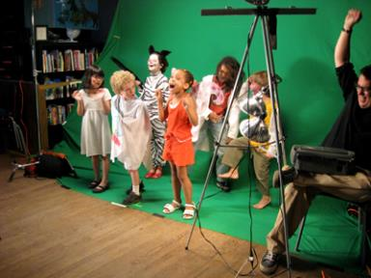
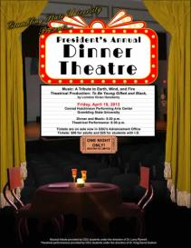
DOCUMENTARY/FILM

Slide 21
APP DESIGN
Blake Copeland. High school freshman creates iPhone app.
Also listen to his talk at ASCD 2010.

Slide 22
BOARD OR VIDEO GAME
Texas 10-year-old Rhys uses Gamestar Mechanic to program and create worlds to play in, learning valuable skills in science, technology, engineering, and math along the way.

Slide 23
MUSICAL PRODUCTION

Slide 24
What are your ideas ? ? ?

